Slide 1
Introduction to Git

Slide 2

Agenda
Introduction
Architecture
Components
Git Hosting Services

Slide 3

Git
Git is Open Source Distributed Version control System. It is a tool for keeping a history for the state of your source code. This also provides source code management.
Installation: Install it with very simple steps.
For Linux
$ apt-get install git
Other systems
https://www.git-scm.com/
Version
$ git --version
Notes:
The name "git" was given by Linus Torvalds when he wrote the very first version. He described the tool as "the stupid content tracker" and the name as (depending on your way):
The development of Git began on 3 April 2005.^{[20]} Torvalds announced the project on 6 April;^{[21]} it became self-hosting as of 7 April.^{[20]} The first merge of multiple branches took place on 18 April.^{[22]} Torvalds achieved his performance goals; on 29 April, the nascent Git was benchmarked recording patches to the Linux kernel tree at the rate of 6.7 patches per second.^{[23]} On 16 June Git managed the kernel 2.6.12 release.^{[24]}

Slide 4
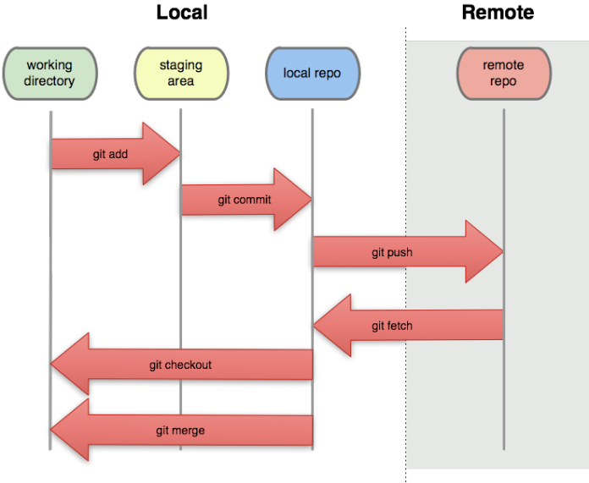
Git Workflow
Git workflow can be divided in two blocks.
Local:
Add local files to staging area
Commit your changes to local repo
Cut branch locally
Merge branches
Remote
Push your committed changes to remote repo.
Pull/Fetch changes from remote to local
Notes:
Pictorial representation of flow of a commit

Slide 5
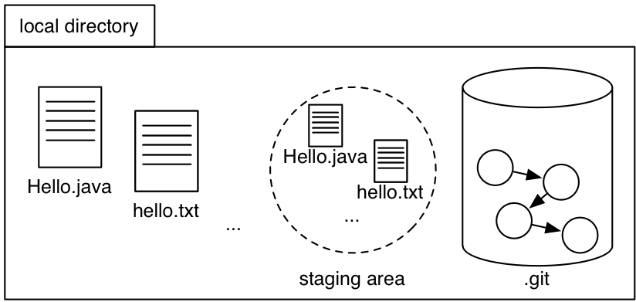
Git Workflow

Slide 6






Git Hosting Services
Notes:
Pictorial representation of flow of a commit

